Slide 1
ETH 2.0
Shahriar Yazdipour

Slide 2

About Me
Shahriar (Sha) Yazdipour
Masters in CS from TUI
Software Engineer at TomTom
hi@yazdipour.com
https://yazdipour.com

Slide 3
Introduction to Ethereum
The network was launched in 2015.
The second-largest cryptocurrency and the blockchain network.
The largest developer ecosystem.
Different from Bitcoin: it can store and execute smart contracts, which are software programs that can be used as applications on the network.
Notes:
The early assurance of Ethereum was to create a decentralized world computer which would execute anyone’s code in exchange for a fee, from running a token sale to distributing loans.

Slide 4
ETH 2.0 Serenity
First announced in 2018.
The most ambitious and radical change to be implemented on the network.
Implementation of Proof of Stake consensus algorithm and moving the network away from PoW architecture.

Slide 5
Why the upgrade?

Slide 6
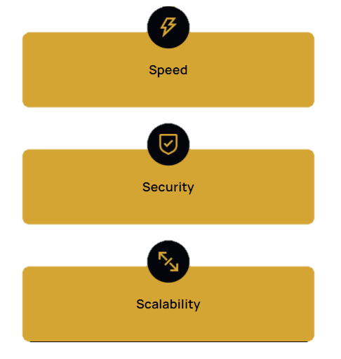
3S Vision
Notes:
The next-generation blockchain networks are trying to create a Net which is … to make the blockchain everlasting [END]

Slide 7
Why the upgrade?
Scalability is the main reason
In ETH1.0, the network can only support around 30 transactions per second which causes delay & congestion.
Ethereum 2.0 promises up to 100,000 tps.
Notes:
VISA averages 1700 transactions/sec and claims it can do 24,000. In Ethereum, every transaction sent to the network has to be processed by ALL the computers of the network, and blockchain data has to be stored by all the computers as well.
Even though Ethereum transactions don’t require a lot of computing power to process , when you multiply this by the number of computers of the network, the processing power needed climbs rapidly.

Slide 8
Why the upgrade?
To make ETH more Secure.
Most PoS networks have a small set of validators, making a more centralized system and decreased network security.
Since PoW suffers from scalability and accessibility issues. PoS replaces it with validators and stake.
Features: Sharding and Staking and DeFi
Notes:
It requires 16,384 validators, making it more secure and decentralized and / implementation of sharding improved scalability of Net.
Not a breaking change for users. It is a change to the Ethereum infrastructure. This means DApp users or DApp developers don’t need to do anything. Therefore, you will be able to use your existing ETH in Eth2.0 without any problems.
POS and Sharding will bring considerable improvements to scalability, security and accessibility.
It estimated that ETH 2.0 Will Use 99.95% Less Energy than ETH 1.0.

Slide 9
ETH2.0 Upgrade Stages
The Beacon Chain
Launched in December 2020. Launch of Beacon Chain.
1
Sharding
In 2021, the first iteration of 64 shards will be launched.
2
The Docking
The merge is when the current ETH 1.0 chain becomes an ETH2.0 shard.
Planned for June 2022.
3
It will be an upgrade where the 64 shards will be fully functional with smart contract compatibility and other added features.
4
Notes:
Phase 0 was the launch of the Beacon Chain, according to the company’s website it “provides the heartbeat to [Ethereum 2.0], the tempo and rhythm for the system’s harmony and consensus.” This was launched on 1 December 2020.
Phase 1, was initially intended to involve implementing shard chains.
Phase 1.5 was then meant to revolve around shard implementation, with the Mainnet being added to the Beacon Chain. The Mainnet was originally meant to be added as the last shard to the Beacon Chain, however, it will now be the first shard added in order to smoothly transition away from PoW.
Phase 2 is under internal discussion and “intense research” and will likely be outlined closer to or after the merge takes place.

Slide 10
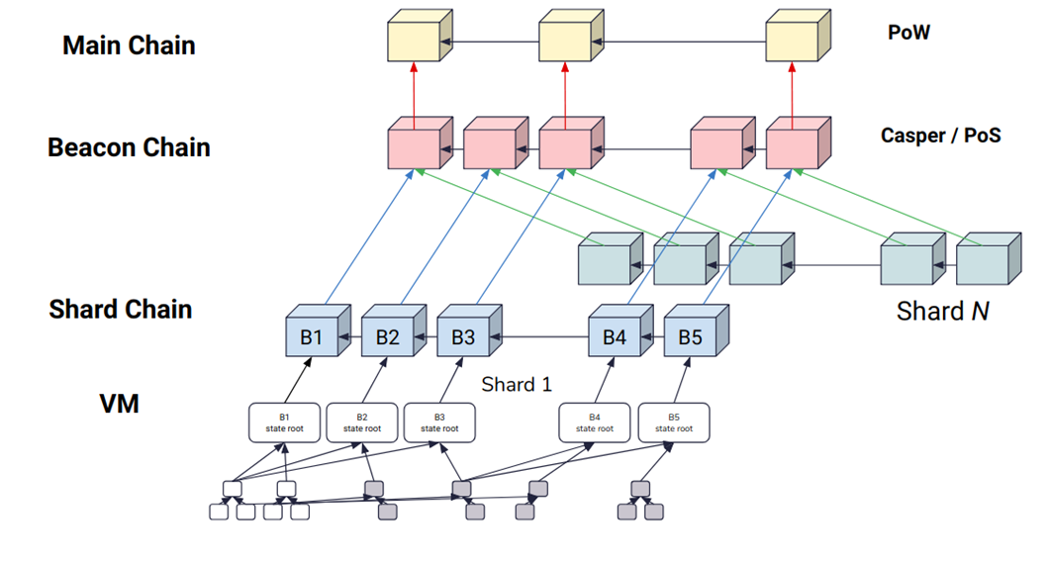
Source: Hsiao-Wei Wang
Notes:
Main chain (i.e the current Ethereum Blockchain)
Beacon chain (i.e Casper)
Shard chains (i.e Sharding)

Slide 11
Staking
This concept provides a new opportunity to participate and receive rewards for maintaining the network.
For those who wish to run their own validators with 32 ETH, use a third-party provider to stake their 32 ETH, or pool their funds with others.
Notes:
We know that, Staking is the process of holding a certain amount of Eth to support the network and get rewards in return
If a person, stakes 32 ETH in their wallet (on VMC Validator Main Contract),they will become a full validator. For staking validators will be rewarded with ETH.
If the ETH holder is unwilling or/and unable to stake 32 ETH they will be elected to use a staking pool, which will combine the funds of others and stake on their behalf.
Pool participants will receive rewards as a percentage of their contribution.
?ETH2.0’s consensus mechanism has a couple of rules that are designed to prevent attacks on the network. Any validator found to have broken the rules of the network will be slashed and ejected from the network.

Slide 12
Sharding
is a solution to bring about scalability.
breaks the blockchain into a set of parallel chains.
The ability to process transactions on different shards in parallel will allow Ethereum to process a larger number of transactions.
Each shard stores the state for a subset of all Ethereum accounts.
A very important shard will be the one for today’s Ethereum mainnet. This will occupy one of the 64 shards. Thus, all the accounts and smart contracts running on ETH1.0, will continue to be neighbors on the same shard.
Notes:
(Sharding refers to horizontally partitioning a blockchain by adding subsets of nodes onto the shard chain to process and validate transactions.)
Initially the goal is that of having 64 shards. process transactions on different shards in parallel will allow ETH to process a larger number of transactions.
This is very different from ETH1 where each full node gets to see and validate all blocks. With sharding different accounts could have their state stored on different shards. This creates an extra layer of complexity whenever an operation involves accounts from different shards. These shard chains are an important part of increasing the number of transactions ethereum can handle per sec.
it will be possible to transfer ETH from the POW chain to a shard chain. POS and sharding will bring considerable improvements to scalability, security and accessibility.
Vitalik compares shards to islands. Whenever a shard hosts all the relevant state information, transactions can be fulfilled within the shard. Otherwise a cross-shard protocol is required for completing an operation.

Slide 13
Shard Chain
Shard Chains store and process transactions.
ETH2.0 will support 1024 Ethereum shard chains, each will be secured by a committee size of 128 validators.
Transactions are only executed and validated within a shard, and that state is only stored at the shard level.
These beacon chains to make sure every shard has the most up-to-date data with the help of validators who communicate the state of shard chains to the beacon chain.
Notes:
These shard chains are an important part of increasing the number of transactions ethereum can handle per sec.
it will be possible to transfer ETH from the POW chain to a shard chain. POS and sharding will bring considerable improvements to scalability, security and accessibility.

Slide 14
Beacon Chain
It is a new blockchain that will serve as the Ethereum 2.0 backbone
Bringing together all the shards.
It provides a crucial coordination point by recording the status of validators, recording attestations (the verification of blocks) and recording links to shards.
Notes:
Regarding the validators, The Beacon chain periodically checks this smart contract and when it finds new validators it adds them to a list of pending validators.
Then it assigns pending validators to random shards, and also re-shuffles the set of already active validators.
This random sampling process is crucial to the security of ETH 2.0 as it prevents validators from colluding and carrying out 51% attack on individual shards.
Proposers send hashes of shard data to the Beacon chain, and attesters sign these hashes if they believe they are valid. These attestations are stored in the blocks of the Beacon chain, but not the shard data itself.

Slide 15
Consensus

Slide 16
Consensus mechanism
the way peers reach a common agreement about the present state of the distributed ledger.
A consensus mechanism in a cryptoeconomic system also helps prevent certain kinds of economic attacks.
In theory, an attacker can compromise consensus by controlling 51% of the network.
Consensus mechanisms are designed to make this "51% attack" unfeasible.
Notes:
we mean that a general agreement has been reached. Consider a group of people going to the cinema. If there is not a disagreement on a proposed choice of film, then a consensus is achieved. In the extreme case the group will eventually split.
In regards to blockchain, the process is formalized, and reaching consensus means that at least 51% of the nodes on the network agree on the next global state of the network.

Slide 17
Proof-of-Work
Block creation is done by miners.
The network is kept secure by the fact that you'd need 51% of the network's computing power to defraud the chain.
This would require such huge investments in equipment and energy; you're likely to spend more than you'd gain.
Notes:
Proof-of-work is done by miners, who compete to create new blocks full of processed transactions. The winner shares the new block with the rest of the network and earns some freshly minted ETH.
The race is won by whosever computer can solve a math puzzle fastest – this produces the cryptographic link between the current block and the block that went before.
Solving this puzzle is the work in "proof-of-work".

Slide 18
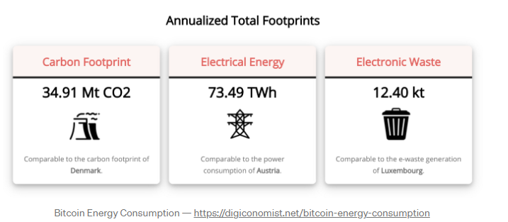
Proof-of-Work
Favors Computing Power
Has an energy problem
More computing power = more control
Notes:
Proof-of-work, or PoW, is the original consensus algorithm in a Blockchain network.
POW is also used in Bitcoin, but with Ethereum instead of processing simple transactions we run computations defined in small programs called smart contracts. This makes the computational load even bigger.
In Blockchain, this algorithm is used to confirm transactions and produce new blocks to the chain. With PoW, miners compete against each other to complete transactions on the network and get rewarded.

Slide 19
Proof-of-Stake
Block creation is done by validators who have staked ETH to participate in the system.
You would need 51% of the total staked ETH to defraud the chain. And that your stake is slashed for malicious behavior.
Notes:
Block creation is done by validators who have staked ETH to participate in the system. (anyone staking 32ETH to create/verify blocks and earn rewards.)
A validator is chosen at random to create new blocks, share them with the network and earn rewards.
Instead of needing to do intense computational work, you simply need to have staked your ETH in the network. This is what incentivizes healthy network behavior.
Stake slashings, ejections, and other penalties, coordinated by the beacon chain, will exist to prevent other acts of bad behavior. Validators will also be responsible for flagging these incidents.

Slide 20
Proof-of-Stake
Slashing conditions:
Validators are split into block proposers and attesters who respectively create and validate new blocks.
If they don’t participate in the vote or if they validate incorrect blocks, their Ether stake will be either reduced or destroyed entirely.
Notes:
The equivalent of this for POW would be a miner who spends a lot of money in electricity to mine an incorrect block, only to have other miners reject his block. In the case of POS, we can produce the same incentive to behave honestly, but without having to spend any electricity.

Slide 21
Proof-of-Stake
Favors Capital
Larger stake = more power
More Performant

Slide 22
Proof of Work
Pros |  | Cons
Security: | Difficult and costly to attack | Energy efficiency: | Mining requires large amounts of computational power which results in high energy consumption and electricity costs
Decentralization: | highly decentralized, which only increases as more miners join the network | Transaction efficiency: | Networks cannot process large transaction volumes resulting in slow and expensive transactions.
Rewards: | Miners are rewarded for solving mathematical equations and creating new blocks | Risk of 51% attack: | Refers to when a miner obtains the majority of the mining power of a network allowing them to more easily tamper with transactions

Slide 23
Proof of Stake
Pros |  | Cons
Transaction efficiency: | Allows for fast transactions and more scalability | Maturity: | PoS is yet to prove itself at scale compared to PoW
Energy efficiency: | Reportedly uses 99% less energy than PoW meaning it is far less damaging for the environment | Decentralization: | Leans more towards centralization as it favours users with high amounts of tokens
Staking: | Provides staking rewards for users who stake a balance of cryptocurrency

Slide 24
Different PoS Variations
Delegated Proof-of-Stake (DPoS)
Liquid Proof-of-Stake (LPoS)
Nominated Proof-of-Stake (NPoS)
Hybrid Proof-of-Stake (HPoS)
…
Notes:
DPoS = election system, in which a fixed number of validators are authorized to secure the network. As a token holder, you get to vote on who will validate transactions on the network, with voting power determined on the size of your stake.
In LPoS, delegation is optional. Token holders can delegate validation rights to other token holders without custody, meaning that the tokens remain in the delegators’ wallet.
NPoS allows for all token holders to participate continuously in the network. Therefore, they maintain a high level of security, while keeping the number of validators bounded.
HPOS is a mix between Proof-of-Work and Proof-of-Stake (ETH)

Slide 25
Attacks on the Ethereum POS Network
Long-range attacks & weak subjectivity
Nothing at stake
[2110.10086] Three Attacks on Proof-of-Stake Ethereum (arxiv.org) Oct 2021
Notes:
For attack #1, increasing the profit of one POS validator to the detriment of others is bad for the network. Delays are bad too.
For attack #2, adversarial networks involve machine learning. With this type of delay, the adversary uses the delay to exploit the network. The exploit, according to page 1 of their paper, uses of strategic voting. They vote to vanish a small number of validators. The problem is with not enough validators voting, it stalls the consensus mechanism. They cannot confirm which is the longest chain. So this stalls the entire network.
For attack 3, they combine the ‘best’ of both previous attacks. The adversary, who holds little to no stake in the network, holds great influence over the network. They can stall it or even create a long-range chain reorg affecting many previously mined blocks.

Slide 26
Long-range attacks & weak subjectivity
Attacker would use the current state of the blockchain at the genesis block, in combination with a significant stake of ETH, to create a malicious new chain that the attacker would trick network users to use.
This new chain would then overtake the main chain and could theoretically rewrite transaction history.
Long-range attacks exist due to weak subjectivity, which affects new nodes that are added to the network or those that come online after a significant amount of time offline.
Creating up-to-date competing chains would take little effort in PoS as opposed to in PoW. Therefore, new nodes or nodes that have been a long time offline have to trust the information they receive from other nodes about which chain is the valid one, causing weak subjectivity.
Notes:
(after 3) These new nodes would not be able to determine which branch is the main chain rightaway. So they depend on other nodes about what the current state of the system is by new or offline nodes.
In proof-of-work systems, a great way to determine the main chain is through the longest chain rule, which reflects the amount of work that has gone into creating the chain.
In PoS systems, weak subjectivity arises because the longest chain rule is not sufficient to determine the main chain due to the costless process of creating an up-to-date chain.
In PoW, it is assumed that long-range attacks, starting at the genesis block, are not possible due to the huge investment of computational resources necessary to reach the main chain length.

Slide 27
Nothing at stake
In a naive proof-of-stake implementation, the economically rational decision would be to put your stake on all forks so that you have a better chance of contributing to the winning fork.
This makes sense since, unlike in PoW where you expend computational energy to contribute to block validation, in naive PoS you have nothing at risk (nothing at stake) when validating and helping to come to a consensus.
This is an issue for consensus because if everyone has a chance to validate on all chains, coming to a consensus about the main chain would be tough.

Slide 28
Conclusion
Does Ethereum 2.0 have these problems? Yes
But ETH2.0 has protective measures.
In the case of weak subjectivity, to ensure that the information about the valid chain is accurate, a node that is new or comes online after a significant period would have to get a recent block hash from a reputable source, such as a blockchain explorer, and insert that as a “checkpoint” into their blockchain client.
A malicious attack would result in slashing, which is enough to make such an attempt too costly to be rationally implemented.
With these measures in place, consequences of misbehavior would be equal to deposit + rewards, as opposed to just rewards in PoW systems.
Notes:
In the case of weak subjectivity, to ensure that the information about the valid chain is accurate, a node that is new or comes online after a significant period would have to get a recent block hash from a reputable source, such as a blockchain explorer, and insert that as a “checkpoint” into their blockchain client. This is the method of dealing with weak subjectivity, which relies on the trust with a reputable source. Although not completely in line with a trustless system, it shouldn’t really be an issue unless the reputable source is compromised.
ETH’s design also intends to remain live through major network partitions, even when a large number of nodes go offline, limiting the influence of weak subjectivity.
This is assumed to improve the potential security of the network.

Slide 29
Conclusion
Will ETH2.0 replace ETH1.0? No.
The present POW chain will run in parallel to the new POS shard chains.
New Ether issuance will take place on the shard chains, and it will be possible to transfer ETH from the POW chain to a shard chain.
Notes:
Another idea is that ETC and ETH could actually complement each other. This means that it is perfectly possible that Ethereum 2.0 could process high volumes of low value transactions, and use Ethereum Classic in the backend to aggregate and settle them with higher finality on a relatively frequent basis. As ETC has a fixed monetary policy, it could also eventually provide sound monetary services to ETH 2.0. In return, Ethereum 2.0 would be providing a very valuable scalability to Ethereum Classic.

Slide 30
Thank you
Any Questions?
hi@yazdipour.com | https://yazdipour.com

